Slide 1
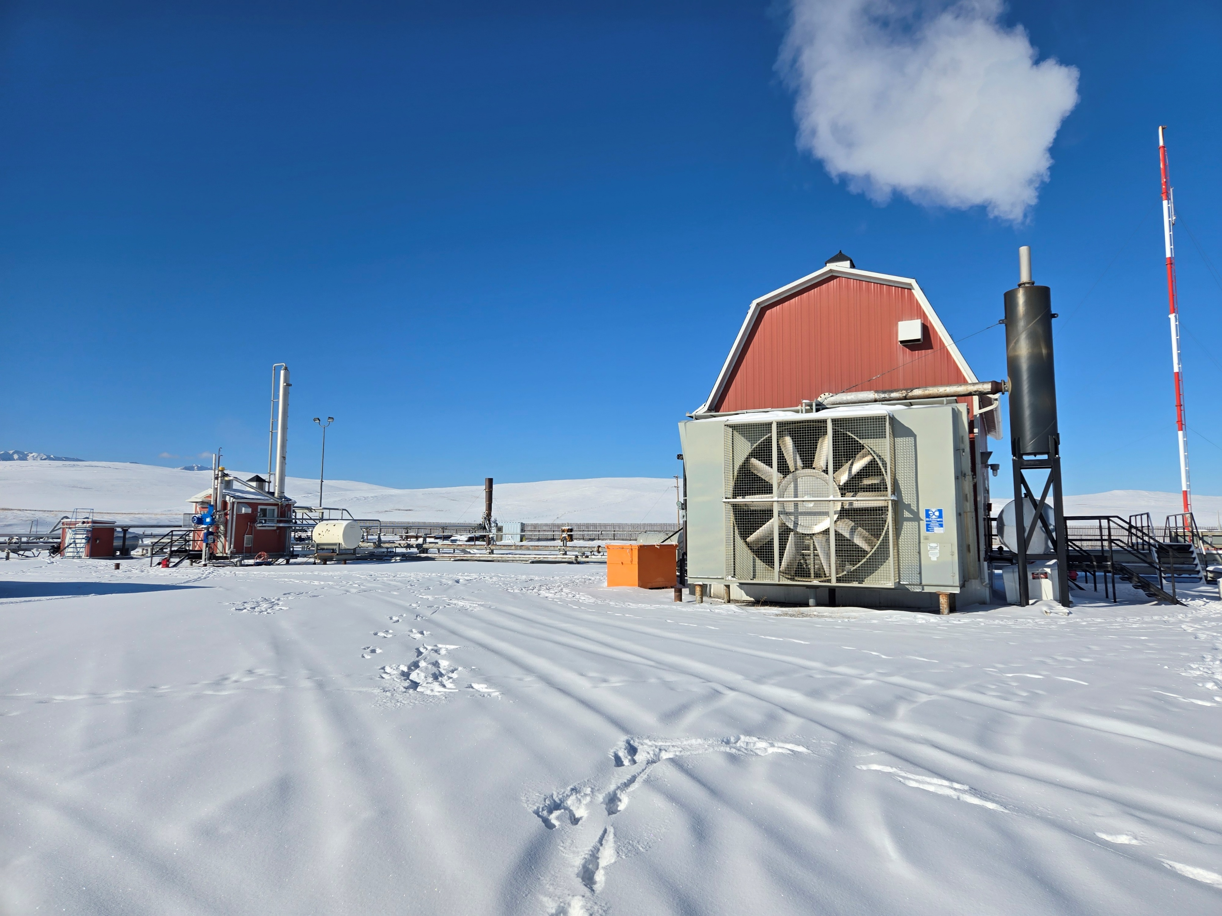

June 2025
Corporate Presentation
Positioned for Success in Light Oil through drilling in the Deep Basin
TSX-V: TUK
www.tukturesources.com

Slide 2





Overview
Capitalization
Q1 2025 operating netback ⁽⁵⁾ of $0.8 MM, providing a solid base for future opportunities
~100 predominantly unbooked⁽⁵⁾, high-potential locations across its asset base (three light oil plays, one conventional natural gas play)
Investment Highlights
Single vertical well production of 66 Mbbl in 172 days suggests a high-permeability reservoir which may extend over 52 sections (~42 ⁽⁶⁾gross sections controlled by Tuktu)
Total Q1/25 production of 705 BOE/d ⁽⁴⁾, 51% light oil, 49% natural gas
Expansive land holdings (as of April 30th, 2025) with ~137 gross sections (~126 net sections), offering significant development potential
Share Price as at May 22,2025
As at March 31, 2025. See March 31, 2025 MD&A dated May 21, 2025
See “Advisories – "Non-GAAP Financial Measures and Ratios”.
BOE/d refers to the Company’s working interest share in gross production.
See “Advisories – Drilling Locations”.
Of the 42 gross sections referenced, Tuktu acquired ~32 sections through past acquisitions and via earning in the farm-in agreement announced by the Company on July 17, 2024 (the “Farm-In Arrangement”); the remaining ~10 sections are unearned lands available for Tuktu pursuant to the Farm-In Arrangement.

Slide 3
Background: Corporate Governance
Board of Directors
Management
Kathleen Dixon
Chair
Former Director, BMO Capital Markets in the Acquisitions and Divestitures Group.
Tim De Freitas
President, CEO & Director
25+ experience, CEO, management, technical and COO rolls in numerous public and private oil and gas companies (Talisman, Nexen, Exxon, Pieridae, Ikkuma, Amarok, Manitok, Trilateral, and others) in and outside Alberta
Bob Dales
Director
Funder/co-founder of Kelt Exploration Ltd., Celtic Exploration Ltd., Peyto Exploration and Development Corp., Amarok Energy Inc., and Manitok. Chairman of Ikkuma Resources Corp.
Mark Smith
VP, Finance & CFO
Chartered Professional Accountant with 20+ years experience in oil and gas companies (Breaker Energy, Wildcat Royalty, Caledonian Midstream)
Greg Feltham
VP, Exploration
20+ years experience of exploration and development. Experience with structural, conventional and resource plays domestically and international. Prior experience in Manitok Energy, Ikkuma Resources, and Pieridae
William Guinan
Director
Lawyer at Borden Ladner Gervais LLP from 1982 until 2021. Director and corporate secretary for numerous public and private corporations over the last 30 years
Sumir Saini
VP, Land & Business Development
20+ years experience, in land & business development; management and executive rolls in Empire Oil Corp., Mount Bastion Oil & Gas, and Bellatrix Exploration; Involved in >$1 billion in M&A transactions.
Natalie Sweet
Director
25 years of exploration and development, including Penn West Exploration Ltd., Apache Canada Ltd. and Mount Bastion Oil and Gas Corp.
Kent Busby
VP, Production
30+ years experience construction and oilfield operations, including the management of >200 field employees. Senior positions in Pieridae, Manitok, and Ikkuma.

Slide 4

Driving Competitive Advantage with Innovation and Expertise
✓
Innovation: Accomplished Team and Board that has a record of finding and developing plays which have fallen out of favor with many other producers
✓
New Pools at a Low Cost: We operate in regions that have been less active, leveraging lower competition and reduced costs, resulting in favorable acquisition metrics
✓
Proven Success since Recapitalization: All the below has been accomplished since Tuktu’s recapitalization transaction in July 2022
✓
Advanced Technical Expertise: Leveraging complex foothills drilling technologies to tap into structured Deep Basin plays, allowing Tuktu to operate in plays that are a natural fit for the team’s unique skill set
✓
A Focus on Conventional Reservoirs: These have greater natural permeability and effective porosity that generally exceed those of unconventional reservoirs; less fracture stimulation and less costly to exploit
Company History and Key Milestones
Acquisition 1:
Closes light oil play in the southern Alberta Foothills; a mostly paper deal for $1.3 MM
Acquisition 3:
Announces light oil production purchase in the southern Alberta deep Basin for $3 MM
Closes on private placement of units for gross proceeds of $1.35 MM
Closes on prospectus offering of units for gross proceeds of $10.05 MM
Equipped new well & brought on production
April
2025
July
2022
March
2023
April
2023
October
2023
December
2023
May
2024
September
2024
November
2024
February
2025
Recapitalized by new team and refocus on oil and gas projects; injects gross $4.67 MM
Acquisition 2:
Closes on natural gas assets for $2.26 million; 100% conventional natural gas and an operated gas plant in southern Alberta
Closes on private placement of units for gross proceeds of $1.6 MM
Closes on Acquisition 3, final consideration of $1.46 MM
Well recompletion announcement
Commence drilling operations
4

Slide 5
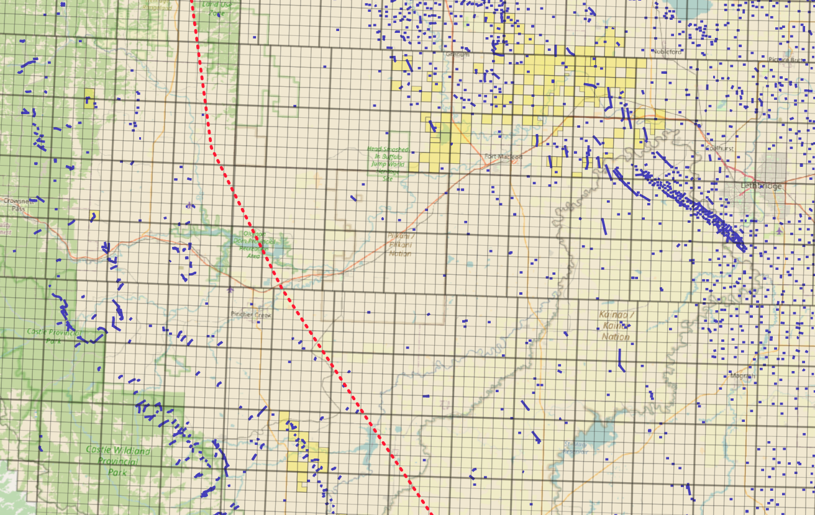
Assets positioned across 4 repeatable plays with 100+ Locations
Tuktu owns ~137 gross sections (126 net sections), mostly in light oil-prone reservoirs in the deep basin
Deep Basin
Foothills
Light oil discovery in structured, Mississippian carbonate/clastic reservoir
Gas prone structured Cretaceous reservoirs, with TUK-100% natural gas plant
Alberta
Lethbridge
Hwy 3
Over pressured deep basin, light-oil charged; moderately structured with regional scale faults and local intense fracture development
Legend
Eastern limit of Foothills
Tuktu Lands
Eastern limit of the foothills belt
Light sweet oil Cretaceous structured reservoir, analogous to the prolific foothills Cardium Stolberg Field

Slide 6
Liquids Weighted Corporate Production
Low decline sweet gas production, mostly through a 100% owned and operated sweet gas plant
Approximately 51% light oil production, with a future capital focus on liquids production in the deep basin and structured assets in the western part of Tuktu’s operational area.
Daily Corporate Net Production⁽¹⁾
(September 2024 to March 29 2025)
Variation in daily oil production is related to obligatory or operational shut-ins of the vertical well in the new middle Banff oil pool.

Slide 7
Tuktu’s Deep Basin Oil Discovery – Penny Upper Banff
In June 2024, Tuktu stimulated a vertical well bore (25-ton slick water frac)
Well on production for 172 days (5.7 months), averaging 386 bbl/d of oil. (66 Mbbl produced over 172 days)
Gas is approximately 6% on a BOE basis; water production continues to be less than 1%.
Low decline and high volume implies a high permeable reservoir. Possible fracture permeability is related to regional fault sets which have been identified on 2D seismic profiles
4-20 Production ⁽¹⁾
UWI
1) Calendar days are shown; periodic well shut in related to nearby drilling, stimulation and regulatory requirements are not shown; well appears to be pump constrained
7
Please see “Advisories – Oil and Gas Advisories – Initial Production Rates”. The 61 days of production data includes an initial 11 days of load fluid recovery. During this time, due to pump rate limitations and load water recovery, oil rates were significantly lower.

Slide 8
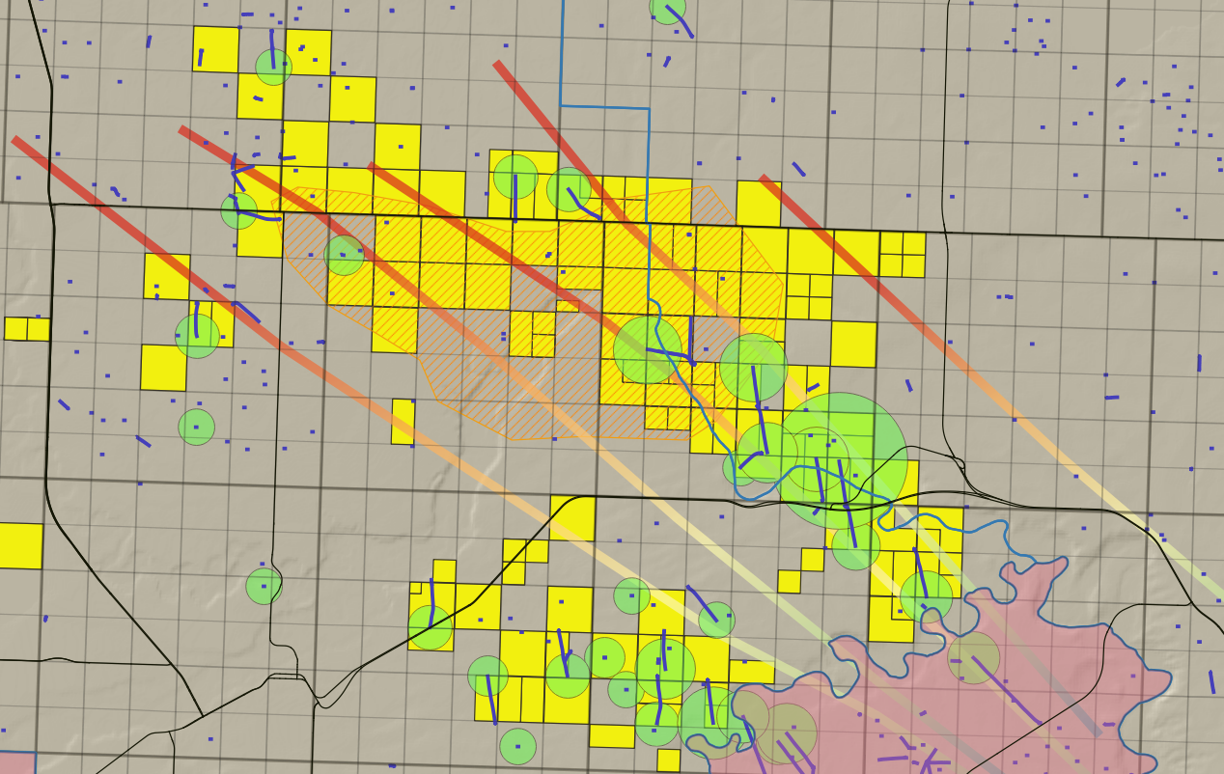
Penny Upper Banff – Play Summary
The area was originally drilled for the lower Banff and Big Valley zones, bypassing the Upper Banff
Based on 6 well intersections, Tuktu estimates an exploitable pool size of about 52 sections
Currently Tuktu holds or has a farm-in option on ~42⁽²⁾ sections within the pool, on which we estimate at least 70 drilling locations ⁽¹⁾
Future drilling plans include the drilling of a horizontal well offsetting the discovery well
Tuktu Lands
Banff sst intersections
Producing Banff sst wells
Banff, Exshaw, Big Valley Production
Approximate Play outline
Basement-involved faults with multiple episodes of deformation
Exact land position held for competitive purposes
Pool Size: 52 sections
Tuktu Land Position: ~42 sections⁽³⁾
Estimated well locations: 70+ ⁽¹⁾
Please see “Advisories – Oil and Gas Advisories – Drilling Locations”.
Of the 70+ locations referenced on this slide, at least 6 locations are booked and the remainder are unbooked. For more information, please refer to “Advisories – Oil and Gas Advisories – Drilling Locations” and disclosure in respect of the Acquisition 3 Reserves Report.
Of the 42 gross sections referenced, Tuktu acquired ~32 sections through past acquisitions and via earning in the farm-in agreement announced by the Company on July 17, 2024 (the “Farm-In Arrangement”); the remaining ~10 sections are unearned lands available for Tuktu pursuant to the Farm-In Arrangement.

Slide 9
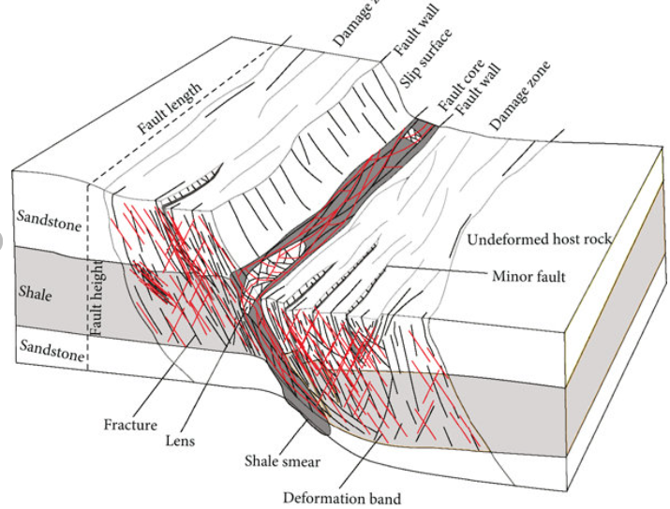
Banff Reservoir: current knowledge base
Current observations of the new play
  Best-in-class, vertical well, producing from a reservoir with exceptional permeability, but with limited porosity
  Natural fracture sets akin to foothills type drilling likely to be controlling factors in well production capability
  Critical fracture distributed to within 1.5 km of regional faults
  Geosteering along fault sets involves similar technologies and skills as applied to foothills reservoirs
  Widespread Banff reservoir, exploitable with unconventional completions technologies (cf. HZ well 1)
Regional basement involved faults
Intense associated fractures appear to control well production
(1)
9

Slide 10
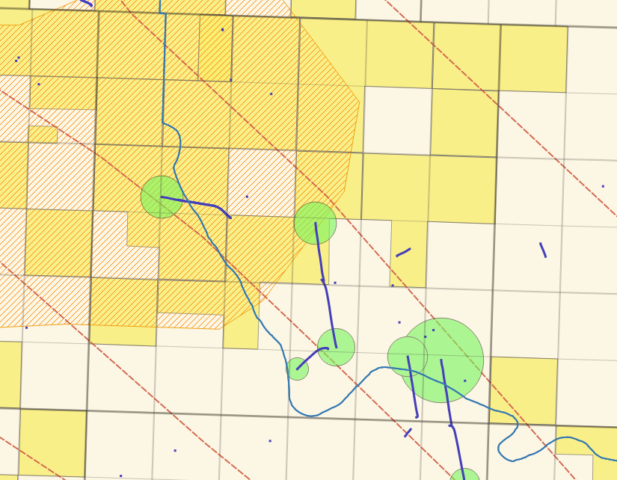
Banff Reservoir: current well performance
4-20 well
  Current production continues to outperform 2P corporate reserves ⁽¹⁾
  Vertical well location is approximately 800 m from an existing, seismically identified fault which is believed to be responsible for prolific rates and minimal decline
Approx pay outline
New 16-20 well
Banff prod.
4-20 well
Regional fault trends
Banff prod.
Numbers show for actual production are gross numbers (Tuktu has an 80% WI). Deloitte values (year-end, 2024) are also gross numbers. Because associated gas is incinerated, gas it is not forecasted to contribute to any reserve class.

Slide 11
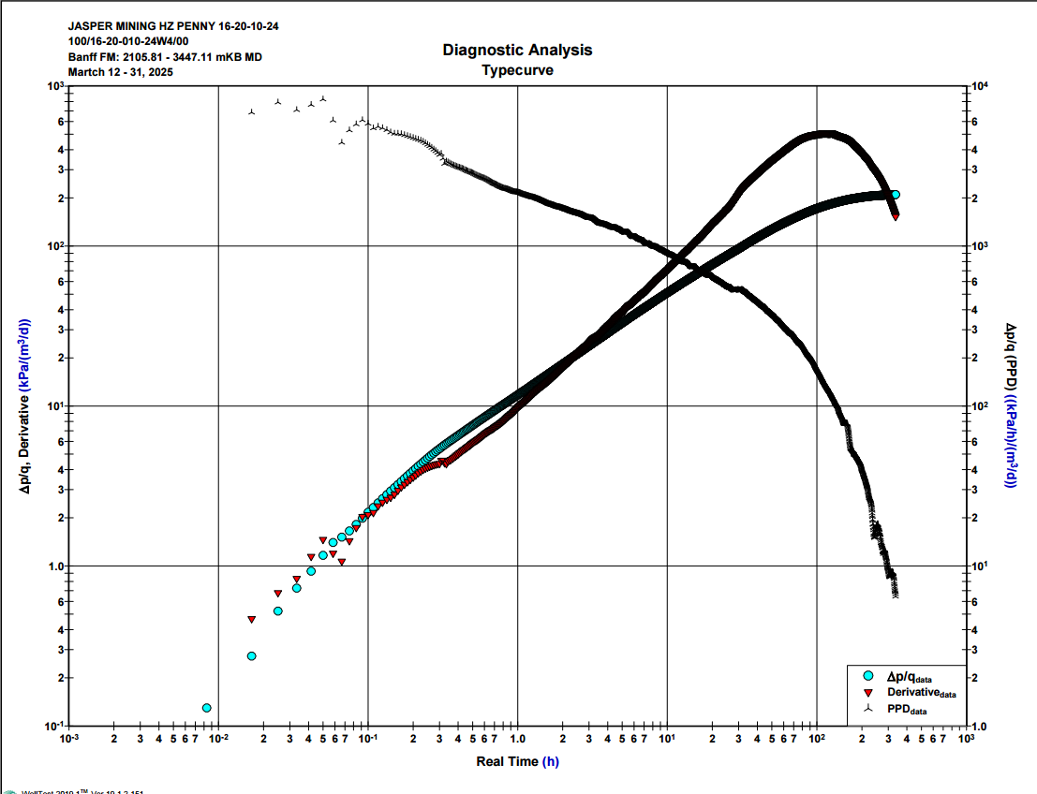
Current HZ well data
16-20 HZ well
  HZ was drilled and stayed within zone for approximately 60% of the lateral; reservoir appears to not as well developed as in the vertical, although open hole logs were not gathered to confirm this.
  Ongoing emulsion issues in the lateral, which formed due to chemical reaction of oil, frac fluids, and perhaps also rock composition. A surfactant pump-from-surface has been effective at restarting pump; 4 of 20 fracs contributing, based on tracer data in late May, 2025
  16-20 and 4-20 well are in communication (see derivative plot), though there does not appear to be significant changes in production or pressure on either of the wells
  Initial, third party estimated Inflow Performance Relationship (“IPR”), which is an estimate of initial production at a given bottom hole pressure, was said to be 75 m3/d (total fluid), but the well has not performed to this level.
  Approximately 30% of load fluid recovered to May 1, 2025)
  Gathering pressure and other data and determining next steps (continued chemical work from surface, or a full wellbore cleanout)
  Gathering further 2D seismic data, because reprocessed line shows potentially an anomaly tied to reservoir occurrence
Approx pay outline
New 16-20 well
Late P-falloff indicates well communication
Banff prod.
4-20 well
Regional fault trends
Banff prod.

Slide 12
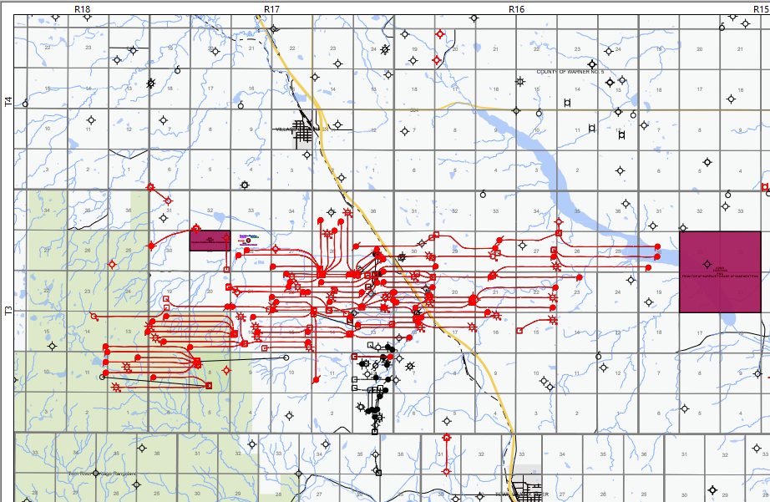
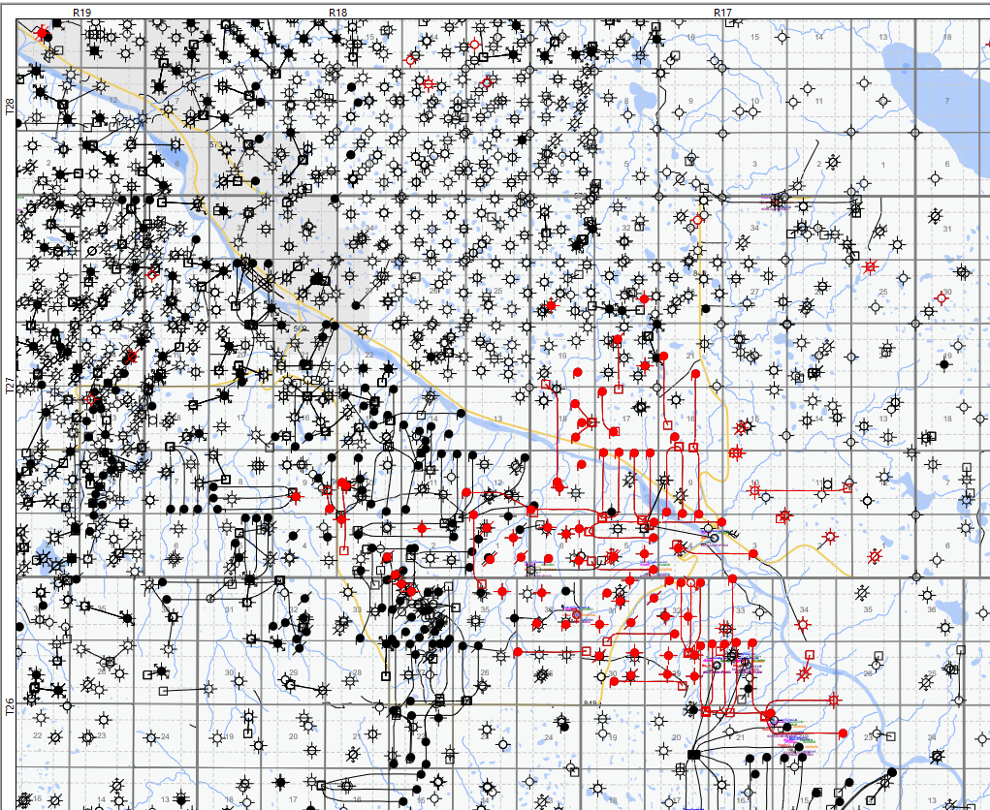
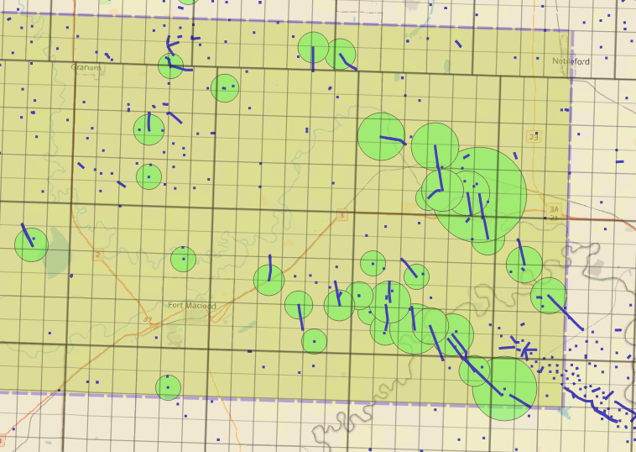
Banff Reservoir: A comparison with Tuktu’s Play 1
The Tuktu deep basin play is the only reservoir of the next 3 examples that has significant fracture-related permeability enhancement and overpressure (pressure gradient ~14.0 kpa/m)
Ferguson
Cessford
Tuktu, deep basin
water
Oil and gas
44 sections (27,923 acres; 11,300 ha)
9.5 millions Bbls ⁽¹⁾
53 sections (33,606 acres; 13,600 ha)
7.5 Million Bbls ⁽¹⁾
52 sections⁽²⁾ (33,112 acres; 13,400 ha)
Fully Developed Field
Porosity | 9%
Original ~ GOR | 2,800 cf/bbl
Initial Pressure | 10,200 kpa
Average Depth | 1290m
Thickness | 12m
Pressure Gradient | 7.8 kpa/m
API | 27.2 API
Recovered to date ⁽¹⁾ | 9.5 million Bbls
Fully Developed Field
Porosity | 8.5%
Original ~ GOR | n/a
Initial Pressure | 6,600 kpa
Average Depth | 1,350 m
Thickness | 4.2 m
Pressure Gradient | 7 kpa/m
API | 28 API
Recovered to date ⁽¹⁾ | 7.5 million Bbls
Undeveloped, Mostly Tuktu
Porosity | 9%
Original ~ GOR | n/a
Anticipated Initial Pressure | 28,300 kpa⁽³⁾
Average Depth | 2,005 m
Thickness | 5 m
Pressure Gradient | 14 kpa/m⁽³⁾
API | 31-33 API
Recoverable Barrel | TBD
(1) All log and cumulative production data is from GeoScout.
(2) The Penny Banff has very few well intersections and only one producing well; there is much greater uncertainty on these values as compared to the numbers for Cessford and Ferguson fields. Also, the later fields are partly under waterflood.
(3) Based on drilling data.

Slide 13
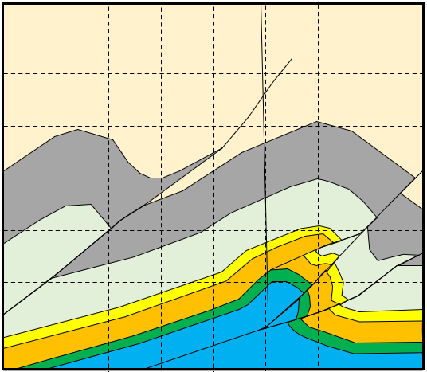
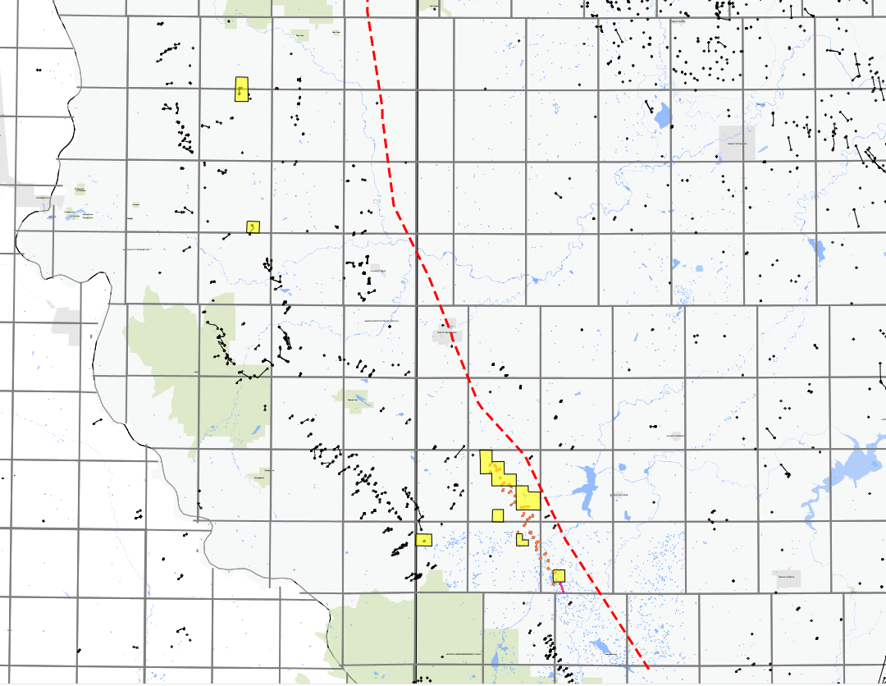
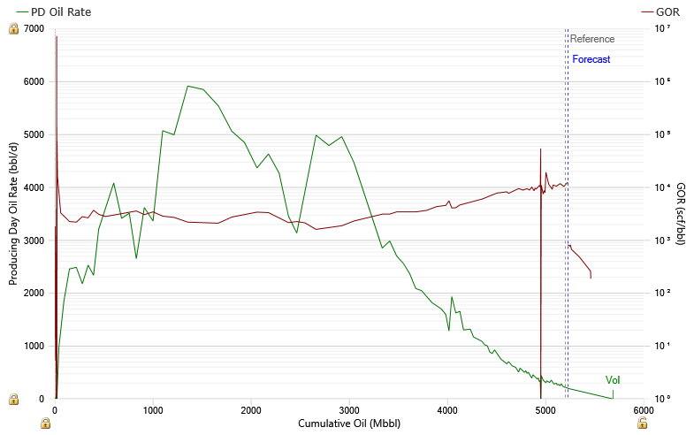
Other fairways within Tuktu’s portfolio: Plays 3 and 4
Play 3
Foothills
Pincher Creek structures
01-11 vertical well
Fractured reservoirs in leading fold structures yield exceptional results
In a report by TD issued during the Stolberg drilling (2010), analysts concluded these to be the most economic Cardium wells in the basin at that time.
Pincher Creek structure is significantly larger and has higher reservoir pressure than Stolberg
40-50 API oil
Foothills, natural gas
Stolberg fractured Cardium⁽¹⁾
Gas prone structured Cretaceous reservoirs, with TUK-100% operated natural gas plant
Significant regional extent
Vertical unstimulated wells can produce up to 8-15 Bcf ⁽²⁾
Work suspended in this area, pending improvement in gas prices
Foothills, light oil play
5.7 million bbls
Oil production forward projections are mathematical fits of current and historic production and declined to an acceptable minimum production level; these numbers should not be interpreted as reserves of such fields and they are estimates only.
The range of 8 to 15 Bcf, is based on TPP reserves as listed in the Deloitte Report (as defined herein). For more information about the Deloitte Report, please refer to “Advisories – Oil and Gas Advisories – Drilling Locations”.

Slide 14
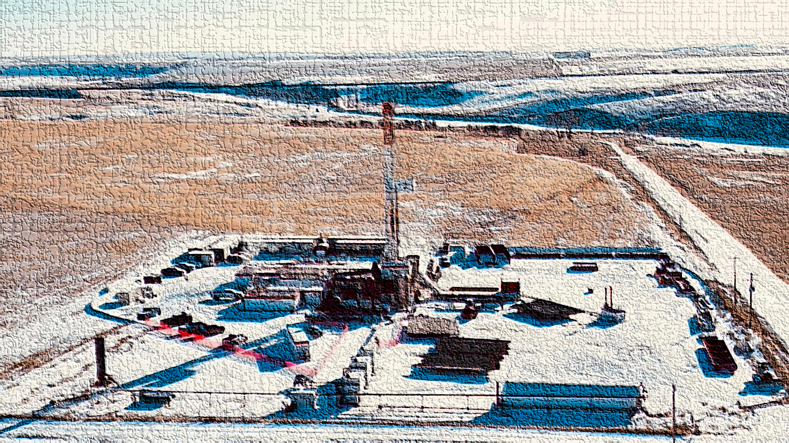
Anticipated use of proceeds from recent financing & income
Q1, 2025
spud vertical HZ
Approximate cost of $5.5 million to drill, complete and equip
Q2-Q3, 2025
1-2 well workovers/recompletions
Q3-Q4, 2025
Pending Board Approval and budgetary constraints, execute one new well
2025 +
Intermittent drilling program targeting regional resource play and sweet spots (fracture fairways) in the upper Banff Play
Continue to exploit lower Banff A and B and Big Valley reservoirs along known faulted fairways (some lower Banff wells are anticipated to exceed 500 Mbbl of production
Gas flood lower Banff play with upper Banff associated gas, for enhanced recovery (this scheme is in approval process with regulators)
14

Slide 15
Why Invest in Tuktu?
Proven management team with history of exploiting new light oil play opportunities and growing production.
Significant exposure to exciting new oil discovery, within a small cap O&G public company
Other zones within the land holdings have similar potential related to reservoir distribution and permeability fairways related to regional faults sets
Near term HZ drilling, offsetting one of the best vertical wells in the basin
With success, likely to attract larger suitors looking to capitalize on Tuktu’s success

Slide 16
APPENDIX
16

Slide 17
Background: About Tuktu Resources Ltd.
Experienced Management Team
Industry leading technical and operational team with direct experience owning and developing profitable assets.
Team has successfully executed a junior growth model twice previously at Manitok Energy Corp. (“Manitok”) and Ikkuma Resources Corp. (“Ikkuma”).
Team is ideally positioned to operate Foothills and Deep Basin assets to drive long-term shareholder value.
Foothills & Deep Basin Consolidation Opportunity
Attractively priced consolidation opportunities exist within the Alberta Foothills and Deep Basin with considerable free cash flow and resource upside.
Due to the exodus into unconventional plays, previous operators have left underexploited reservoirs and under-utilized infrastructure providing an advantage and cost savings for a junior growth company.
Parts of the southern Alberta Deep Basin with a high structural component amenable to exploitation skills developed in the foothills.
The lack of recent development drilling has left Foothills facilities and pipelines underfilled. Operators have plenty of processing capacity and egress for new gas.
Clean Corporate Entity, Attractive Foothills Oil-Prone Acreage
Meaningful investment from insiders
Minimal asset retirement obligations
Pro forma, the Company has identified ~100 unbooked drilling locations ⁽¹⁾ across four independent play types ⁽²⁾ on the acquired land base.
See “Advisories – Oil and Gas Advisories – Drilling Locations".
See "Advisories – Oil and Gas Advisories – Analogous Information".

Slide 18



Background: Track Record of Success of Tuktu Team Members
July 2010 to Oct. 2013
May 2014 to Dec. 2018
Dec. 2018 to Jan. 2021
Went public via an amalgamation with private company, previously having raised $18MM in equity via private placements since being founded in 2005, with Mr. de Freitas serving as VP, Exploration and COO.
Completed a number of acquisitions and undertook meaningful exploration and development activities within the Central and Southern Alberta Foothills.
Manitok was focused on both heavy oil, and Foothills natural gas, in many of the same areas where the Tuktu team is currently targeting M&A.
Went public via a reverse take-over of a public company, with a concurrent $20MM private placement, and a rights offering to existing public company shareholders.
Ikkuma subsequently undertook a successful $120MM asset acquisition in the Foothills region funded with a $130MM bought equity deal.
The team would complete a number of additional acquisitions and equity raises, until Ikkuma was ultimately sold to Pieridae in December 2018 (~300% premium to VWAP). The team additionally negotiated a spin out transaction as part of the sale, driving incremental value for all shareholders.
Mr. de Freitas, in addition to other members of the Tuktu team, joined Pieridae at the closing of the Ikkuma transaction and remained with the company as it undertook the transformational Shell Foothills acquisition in 2019.
The Foothills transaction closed in late-2019, adding ~28,000 BOE/d in the Alberta Foothills, in addition to a number of facilities, for a total purchase price of $190MM. The Tuktu team was integral throughout the acquisition and subsequent integration.

Slide 19
Advisories
FORWARD-LOOKING INFORMATION ADVISORIES
Certain information contained in the press release may constitute forward-looking statements and information (collectively, “forward-looking statements”) within the meaning of applicable securities legislation that involve known and unknown risks, assumptions, uncertainties and other factors. Forward-looking statements may be identified by words like “anticipates”, “estimates”, “expects”, “indicates”, “intends”, “may”, “could” “should”, “would”, “plans”, “target”, “scheduled”, “projects”, “outlook”, “proposed”, “potential”, “will”, “seek” and similar expressions (including variations and negatives thereof). Forward-looking statements in this document include statements regarding, among other things: Tuktu’s business, strategy, objectives, strengths and focus; the Company’s drilling and development program, including its next drilling location and timing of same; the performance and other characteristics of the Company’s properties, including the Company’s recently drilled southern Alberta Deep Basin horizontal well; expectations regarding decline rates; expectations regarding the Company’s seismic reprocessing project; management’s expectations regarding reservoir characteristics and recovery factors and interpretation of its 2D seismic data, including localized areas of enhanced permeability and recoverable reserves; and expected results from its assets. Such statements reflect the current views of management of the Company with respect to future events and are subject to certain risks, uncertainties and assumptions that could cause results to differ materially from those expressed in the forward-looking statements. Statements relating to production, reserves, recovery, replacement, costs and valuation are also deemed to be forward-looking statements, as they involve the implied assessment, based on certain estimates and assumptions, that the reserves described exist in the quantities predicted or estimated and that the reserves can be profitably produced in the future. With respect to forward-looking statements contained in this document, the Company has made assumptions regarding, among other things: the timing and success of future drilling; future commodity prices, price volatility, price differentials and the actual prices received for Tuktu’s products; fairway characteristics; future exchange and interest rates; supply of and demand for commodities; inflation; the availability of capital on satisfactory terms; the availability and price of labour and materials; the impact of increasing competition; conditions in general economic and financial markets; access to capital; the receipt and timing of regulatory, exchange and other required approvals; the ability of the Company to implement its business strategies and complete future acquisitions; the Company's long term business strategy; and effects of regulation by governmental agencies. Factors that could cause actual results to vary from forward-looking statements or may affect the operations, performance, development and results of the Company‎’‎s businesses include, among other things: risks inherent in the Company's future operations; the Company‎’‎s ability to generate sufficient cash flow from operations to meet its future obligations; increases in maintenance, operating or financing costs; the realization of the anticipated benefits of future acquisitions, if any; the availability and price of labour, equipment and materials; competitive factors, including competition from third parties in the areas in which the Company intends to operate, pricing pressures and supply and demand in the oil and gas industry; stock market and financial system volatility; fluctuations in currency and interest rates; inflation; risks of war, hostilities, civil insurrection, pandemics, political and economic instability overseas and its effect on commodity pricing and the oil and gas industry (including ongoing military actions between Russia and Ukraine and the crisis in Israel and Gaza); determinations by the Organization of Petroleum Exporting Countries and other countries (collectively referred to as OPEC+) regarding production levels and the risk of an extended period of low oil and natural gas prices; the imposition or expansion of tariffs imposed by domestic and foreign governments or the imposition of other restrictive trade measures, retaliatory or countermeasures implemented by such governments, including the introduction of regulatory barriers to trade and the potential effect on the demand and/or market price for the Company’s products and/or otherwise adversely affects the Company; risks with respect to unplanned pipeline outages; severe weather conditions and risks related to climate change, such as fire, drought and flooding and extreme hot or cold temperatures, including in respect of safety, asset integrity and shutting-in production; terrorist threats; risks associated with technology; changes in laws and regulations, including environmental, regulatory and taxation laws, and the interpretation of such changes to the management team‎’‎s future business; availability of adequate levels of insurance; difficulty in obtaining necessary regulatory approvals and the maintenance of such approvals; general economic and business conditions and markets; and such other similar risks and uncertainties. The impact of any one assumption, risk, uncertainty or other factor on a forward-looking statement cannot be determined with certainty, as these are interdependent and the Company's future course of action depends on the assessment of all information available at the relevant time. For additional risk factors relating to Tuktu, please refer to the Company’s annual information form for the year ended December 31, 2024, and its most recent MD&A, which are available on the Company’s SEDAR+ profile at www.sedarplus.ca.
FORWARD LOOKING FINANCIAL INFORMATION
This document contains future-oriented financial information and financial outlook information (collectively, “FOFI") about the development plan, anticipated capital expenditures in 2025, anticipated 2025 operating netback, and prospective operational and financial results of the Company’s assets, all of which are subject to the same assumptions, risk factors, limitations, and qualifications as set forth in the above paragraphs. FOFI contained in this document was approved by management as of the date of this document and was provided for the purpose of providing further information about the Company's future business operations, the Company disclaims any intention or obligation to update or revise any FOFI contained in this document, whether as a result of new information, future events or otherwise, unless required pursuant to applicable securities laws. Readers are cautioned that the FOFI contained in this document should not be used for purposes other than for which it is disclosed herein.
NON-GAAP AND OTHER FINANCIAL MEASURES
This document uses various specified financial measures (as such terms are defined in National Instrument 52-112 – Non-GAAP Disclosure and Other Financial Measures Disclosure ("NI 51-112")) including "non-GAAP financial measures", "non-GAAP ratios" and "supplementary financial measures" (as such terms are defined in NI 51-112), which are described in further detail below. Management believes that the presentation of these non-GAAP measures provide useful information to investors and shareholders as the measures provide increased transparency and the ability to better analyze performance against prior periods on a comparable basis. These non-GAAP and other financial measures are not standardized financial measures under IFRS and might not be comparable to similar measures presented by other companies where similar terminology is used. Investors are cautioned that these measures should not be construed as alternatives to or more meaningful than the most directly comparable IFRS measures as indicators of the Company's performance.
Operating Netback , non-GAAP financial measure
Management feels operating netback is a key industry benchmark and measure of operating performance of the Company that assists management and investors in assessing the Company's profitability and is commonly used by other petroleum and natural gas producers. Operating netback is calculated as petroleum and natural gas revenue less royalties, transportation and operating expenses.
Enterprise Value, non-GAAP financial measure
The Company uses "enterprise value" as a key performance indicator. Enterprise value is calculated by adding the Company's market capitalization and market value of the Company's outstanding debt, less any cash or cash equivalents.
Adjusted working capital
Adjusted working capital is calculated by taking working capital (current assets less current liabilities) and adding back the warrant liability and current portion of decommissioning obligations. Management believes that adjusted working capital assists management and investors in assessing Tuktu’s short-term liquidity.

Slide 20
Advisories
OIL AND GAS ADVISORIES
RESERVES INFORMATION: All reserves information are from the Corporation’s 2024 year end reserve report prepared by Deloitte LLP. Values therein were based on the average price and market forecasts of Deloitte LLP as of January 1, 2025. The recovery and reserve estimates of the crude oil, natural gas liquids and natural gas reserves provided herein are estimates only and there is no guarantee that the estimated reserves will be recovered. Actual crude oil, natural gas and natural gas liquids reserves may be greater than or less than the estimates provided herein.
This document contains estimates of the NPV of the Company's future net revenue from reserves associated with the Company’s assets (including assets acquired pursuant to recent acquisitions), as applicable. Such amounts do not represent the fair market value of such reserves. The recovery and reserve estimates provided herein are estimates only and there is no guarantee that the estimated reserves will be recovered. The NPV of the respective assets' base production is a snapshot in time and is based on the reserves evaluated using the applicable pricing assumptions described above. The NPV is calculated using a discount rate of 10%, on a before tax basis and is the sum of the present value of proved plus probable developed producing reserves based on the applicable pricing assumptions. It should not be assumed that the undiscounted or discounted NPV of future net revenue attributable to the respective assets represents the fair market value of those assets. The estimates for reserves for individual properties may not reflect the same confidence level as estimates of reserves for all properties due to the effects of aggregation. The recovery and reserve estimates of crude oil, NGL and natural gas reserves are estimates only and there is no guarantee that the estimated reserves will be recovered. Actual reserves may be greater than or less than the estimates relied upon for NPV calculations, herein.
BOE ADVISORY: The term "BOE" or barrels of oil equivalent may be misleading, particularly if used in isolation. A BOE conversion ratio of six thousand cubic feet of natural gas to one barrel of oil equivalent (6 Mcf: 1 bbl) is based on an energy equivalency conversion method primarily applicable at the burner tip and does not represent a value equivalency at the wellhead. Additionally, given that the value ratio based on the current price of crude oil, as compared to natural gas, is significantly different from the energy equivalency of 6:1; utilizing a conversion ratio of 6:1 may be misleading as an indication of value.
INITIAL PRODUCTION RATES: References in this document to IP, IP30 or IP60 rates, other short-term production rates or initial performance measures relating to new wells are useful in confirming the presence of hydrocarbons; however, such rates are not determinative of the rates at which such wells will commence production and decline thereafter and are not indicative of long-term performance or of ultimate recovery. All IP rates presented herein represent the results from wells after all "load" fluids (used in well completion stimulation) have been recovered. While encouraging, readers are cautioned not to place reliance on such rates in calculating the aggregate production for the Company. Accordingly, the Company cautions that the test results should be considered to be preliminary.
DRILLING LOCATIONS: This document discloses drilling locations in two categories: (i) booked locations; and (ii) unbooked locations. Booked locations identified in this document reflect drilling locations that have associated proved and/or probable undeveloped reserves, as applicable, and were derived from the evaluation prepared by Deloitte Canada LLP (“Deloitte”) dated effective December 31, 2024, with a preparation date of March 24, 2025(the “Deloitte Report”), evaluating substantially all of Tuktu’s assets. Of the total approximately 100 drilling locations identified herein across the Company’s asset base, at least 70 locations were identified within the Pennf Upper Banff subject to the Farm-In Arrangement (of which at least 6 locations are booked, probable locations and the remainder are unbooked locations) and at least 30 locations were identified within the Company’s properties (of which at least 1 location is a booked, probable location and the remainder are unbooked locations). The Deloitte Report was prepared in accordance with NI 51-101 and COGEH. Unbooked drilling locations are the internal estimates of Tuktu based on the prospective acreage of the Tuktu assets (including recently acquired assets), and an assumption as to the number of wells that can be drilled per section based on industry practice and internal review. Unbooked locations do not have attributed reserves or resources (including contingent and prospective). Unbooked locations have been identified by Tuktu's management as an estimation of Tuktu's multi-year drilling activities based on evaluation of applicable geologic, seismic, engineering, production and reserves information. There is no certainty that Tuktu will drill all unbooked drilling locations and if drilled there is no certainty that such locations will result in additional oil and natural gas reserves, resources or production. The drilling locations on which Tuktu will actually drill wells, including the number and timing thereof is ultimately dependent upon the availability of funding, regulatory approvals, seasonal restrictions, oil and natural gas prices, costs, actual drilling results, additional reservoir information that is obtained and other factors. While a certain number of the unbooked drilling locations have been de-risked by Tuktu, drilling existing wells in relatively close proximity to such unbooked drilling locations, the majority of other unbooked drilling locations are farther away from existing wells, where subsurface information is scarce and thus such locations will not necessarily result in the addition of booked oil and gas reserves, resources, or production.
ANALOGOUS INFORMATION & TYPE CURVES: Certain information in this document may constitute "analogous information" as defined in NI 51-101, with respect to Tuktu’s assets including, but not limited to, information relating to well locations that are in geographical proximity to or believed to be on-trend with other drilling locations acquired by the Company. This analogous information is derived from publicly available information sources which the Company believes are predominantly independent in nature. Some of this data may not have been prepared by qualified reserves evaluators or auditors and the preparation of any estimates may not be in strict accordance with COGEH. There is no certainty that the results of the analogous information or inferred thereby will be achieved by the Company and such information should not be construed as an estimate of future production levels or the actual characteristics and quality of the Company’s assets. Certain type curves disclosure presented herein represents volumes expected to be recovered from wells. The type curves represent what management thinks an average well will achieve, based on methodology that is analogous to wells with similar geological features. Individual wells may be higher or lower but over a larger number of wells, management expects the average to come out to the type curve. Over time, type curves can and will change based on achieving more production history on older wells or more recent completion information on newer wells. The reader is cautioned that the data relied upon by the Company may be in error and/or may not be analogous to the Company’s land holdings.
THIRD PARTY INFORMATION: Certain market, third party and industry data contained in this presentation is based upon information from government or other industry publications and reports or based on estimates derived from such publications and reports. Government and industry publications and reports generally indicate that they have obtained their information from sources believed to be reliable, but the Company has not conducted its own independent verification of such information. No representation or warranty of any kind, express or implied, is made by the Company as to the accuracy or completeness of the information contained in this document, and nothing contained in this report is, or shall be relied upon as, a promise or re-report by the Company.
OIL AND GAS METRICS: This document contains certain oil and gas metrics which do not have standardized meanings or standard methods of calculation and therefore such measures may not be comparable to similar measures used by other companies and should not be used to make comparisons. Such metrics have been included in this document to provide readers with additional measures to evaluate the Company's performance; however, such measures are not reliable indicators of the Company's future performance and future performance may not compare to the Company's performance in previous periods and therefore such metrics should not be unduly relied upon.

Slide 21
Advisories
PRICING ASSUMPTIONS
$CDN/bbl | $CDN/mcf | YEAR
91.07 | 2.23 | 2025
88.30 | 2.34 | 2026
86.70 | 2.44 | 2027
85.61 | 2.53 | 2028
85.95 | 2.60 | 2029
87.68 | 2.67 | 2030
US DISCLAIMER
This presentation does not constitute an offer of the securities for sale in the United States. The securities have not been registered under the U S Securities Act of 1933 as amended, and may not be offered or sold in the United States absent registration or an exemption from registration. This presentation shall not constitute an offer to sell or the solicitation of an offer to buy nor shall there by any sale of the securities in any state in which such offer, solicitation or sale would be unlawful.
ABBREVIATIONS
Terms and abbreviations that are used in this document that are not otherwise defined herein are provided below:
API – American Petroleum Institute
bbl(s) - barrel(s)
bbls/d - barrels per day
Bcf – billion cubic feet
boe - barrels of oil equivalent (6 Mcf = 1 bbl)
boe/d – barrels of oil equivalent per day
CAPEX – capital expenditures
IP30 - initial production over the first 30-days on stream
kpa - kilopascal
Mbbl - thousand barrels of oil
Mboe – million barrels of oil equivalent
MM - millions
MMbbl - million barrels of oil
Mcf - thousand cubic feet
NPV - net present value
NPV10 - net present value using a 10% discount rate
NGL - natural gas liquids as defined in NI 51-101
PDP - proved developed producing
TPP - total proved plus probable

